Slide 1

Midterm Project
Car Rental Service
C-450
Joshua Willis

Slide 2
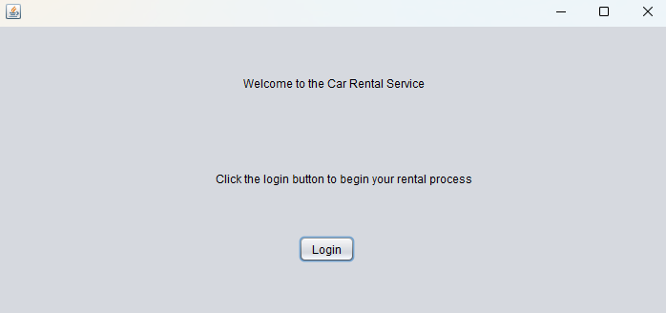
Car Rental Program
A product for users looking to rent a vehicle that allows them to browse available cars and choose one to rent.

Slide 3
Program Features

Slide 4
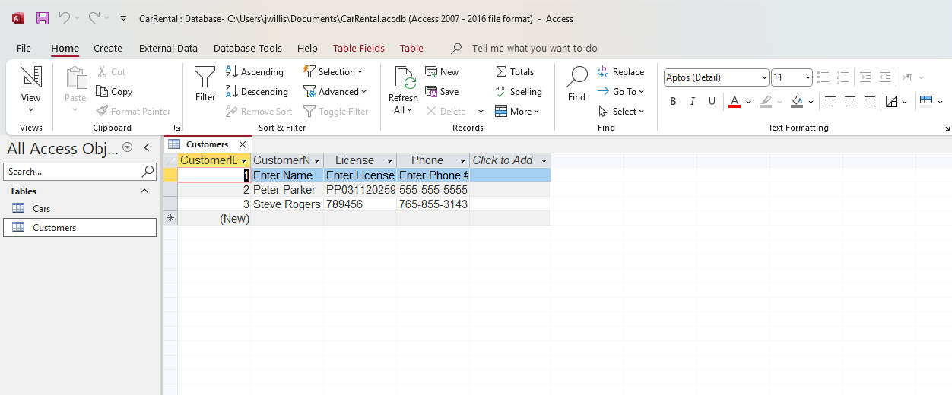
Database backend
Program data is stored in a Microsoft Access database

Slide 5

Demo Roadmap
In the demo video I’ll walk through a basic process for first-time users:
Start the program
Create a new customer
Select the new customer
Browse available cars
See daily cost for a car
Choose car for rent
Choose number of days for rental
Checkout

Slide 6

Demo Presentation

